Slide 1




AeroFile
Operator Registration
Prepared by:
Lava Protocols Sdn Bhd
Lava Protocols Sdn. Bhd. © 2018. All Rights Reserved. This content is not to be distributed

Slide 2
Before Registration
Browser: Highly recommended that Google Chrome (latest version) with Incognito mode is used to perform the registration submission.
Connectivity: Certain corporate firewall policies may have restrictive properties towards the AeroFile's registration form!
  If this happens, it would be advisable to use personal mobile internet (ie. tethered) to the PC/laptop being used to perform the registration.

Slide 3
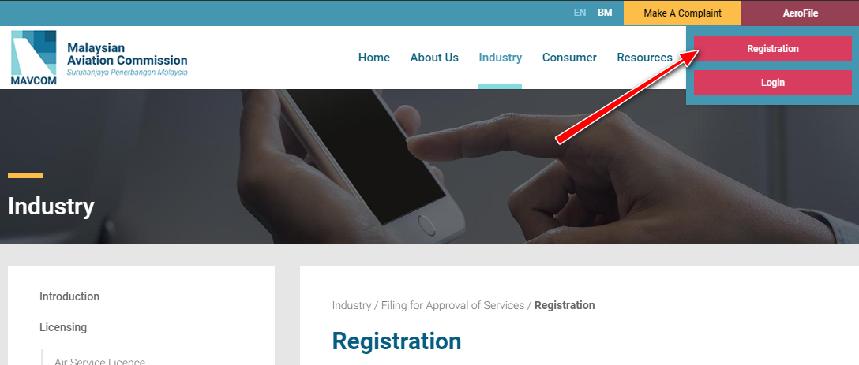
Registration Process
To register:
Navigate to MAVCOM’s website https://www.mavcom.my/en/home/
At the top right hand side of the page, mouse over on the Aerofile button and then click on the Registration button.

Slide 4
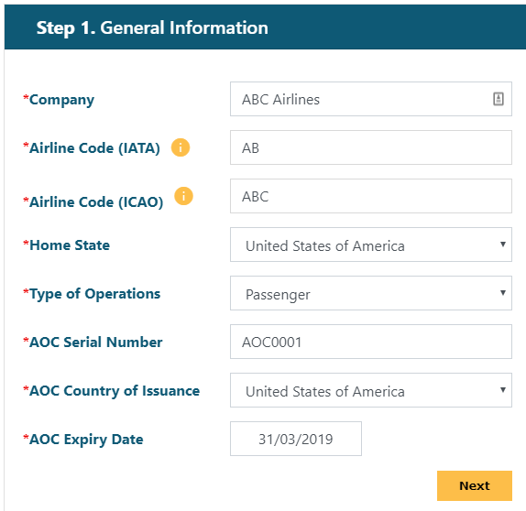
General Information
Please ensure to provide all the mandatory details at
Step 1. General Information
  Note:
  Fields marked with the red asterisk (*) are mandatory to be entered.
  For IATA Code, max 2 characters.
  For ICAO Code, either 3 or 4 characters at max.
Once completed, click the Next button.

Slide 5
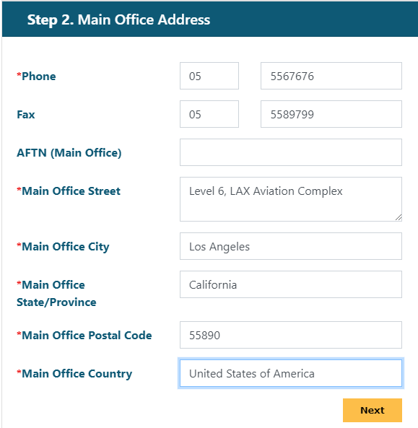
Main Office Address
Then proceed to fill up details at Step 2. Main Office Address.
  Note:
  Fields marked with the red asterisk (*) are mandatory to be entered.
Once completed, click the Next button.

Slide 6
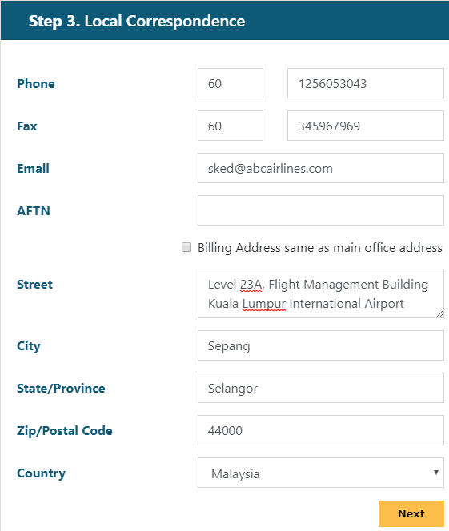
Local Correspondence
Please fill the detail at Step 3. Local Correspondence.
  Note:
  This section is only required if the Airline has a local (Malaysia) based representative.
Once completed, click the Next button.

Slide 7
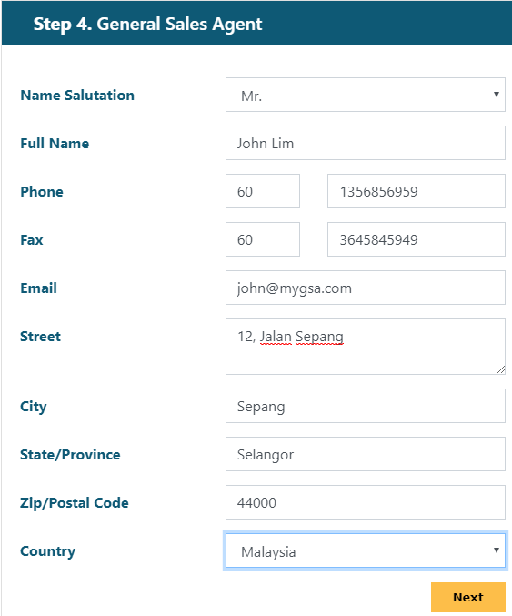
General Sales Agent
In the event the airline engages a General Sales Agent, please ensure to provide the requested detail as per Step 4. General Sales Agent.
Once the detail is completed then click the button Next

Slide 8
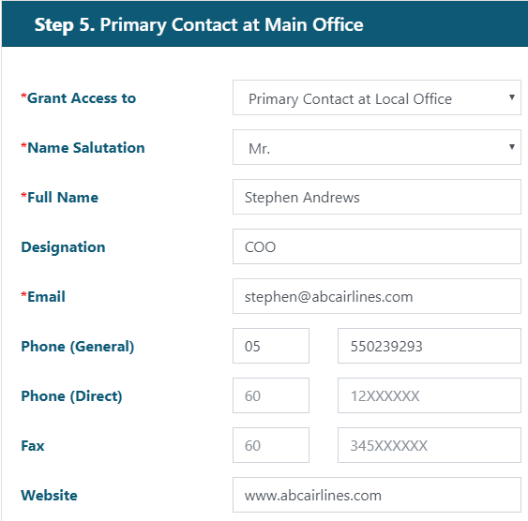
Primary Contact at Main Office
Please enter the detail at
Step 5. Primary Contact at Main Office.
Once the detail is completed, and then please click the button Next.

Slide 9
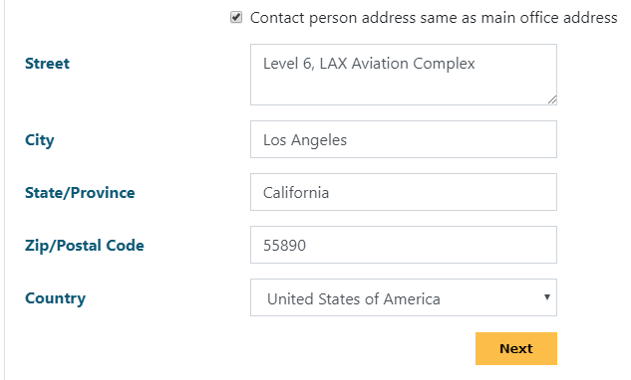
Primary Contact at Main Office (cont)
Click on the Same address as Local Correspondence checkbox to quickly copy and populate the same details as entered earlier.
Once the detail is completed, and then please click the button Next.

Slide 10
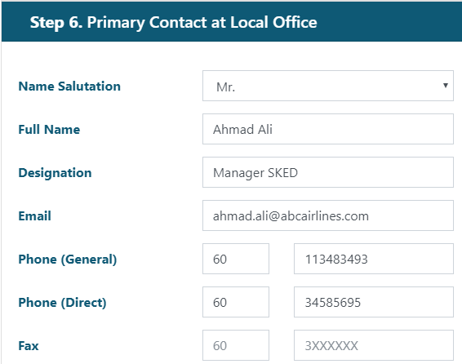
Primary Contact at Local Office
Please enter the detail at
Step 6. Primary Contact at Local Office.
Note:
In the event the same contact person is already entered in the previous section (Main Office Contact), kindly refrain from repeating the same entry within this section.

Slide 11
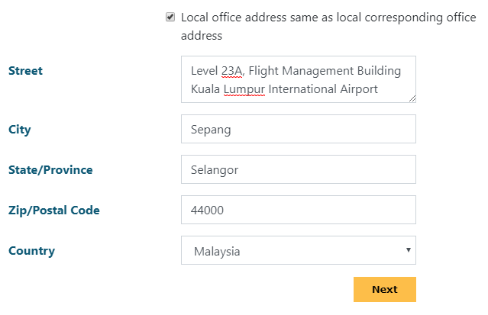
Primary Contact at Local Office (cont)
Click on the Same address as Local Correspondence checkbox to quickly copy and populate the same details as entered earlier.
Once the detail is completed, and then please click the button Next.

Slide 12
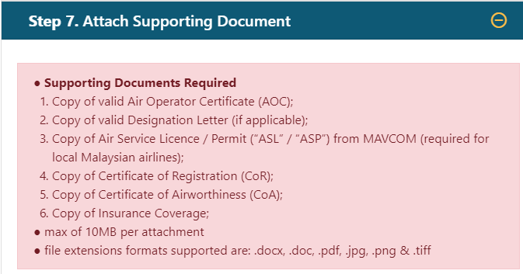
Attach Supporting Document
Please submit the required document at Step 7. Attach Supporting Document
Notes:
Prepare all required documents with authorised signatories in the prescribed format.
Airlines are expected to upload all the documents listed in this section.
Maximum size is 10MB per attachment
File extensions formats supported are: .docx, .doc, .pdf, .jpg, .png & .tiff

Slide 13
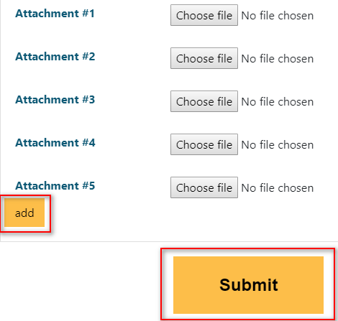
Attach Supporting Document (cont.)
To upload more then 5 document (max to 10), click the Add button.
Once the documents have been uploaded, and all required details have been entered, lastly click the Submit button to complete the registration submission.

Slide 14
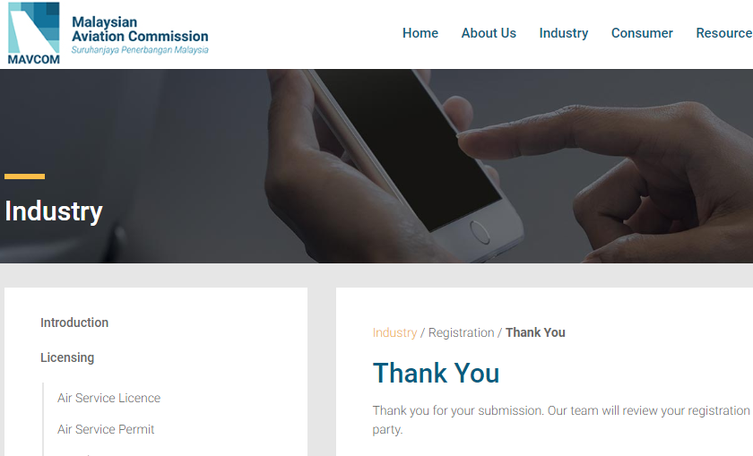
Successful Submission
In the event that the registration submission is successful, the applicant will be automatically directed to the Thank You page.
The Airline shall also receive a verification email shortly as receipt of acknowledgement of the submission.

Slide 15
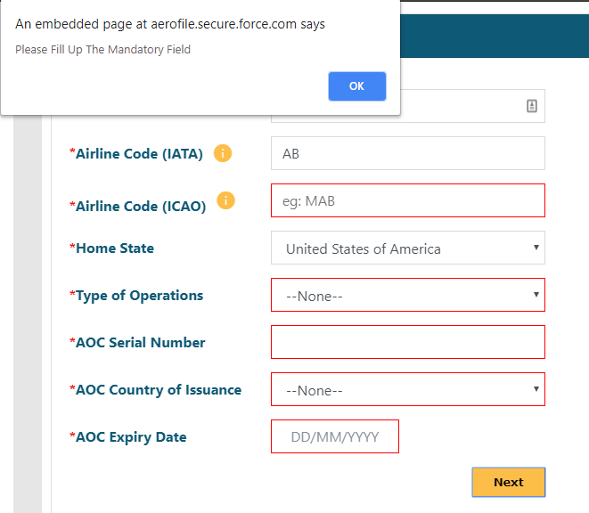
Unsuccessful Submission
Scenario A
In the event any required field is empty and the application clicks on Next or Submit, the missing fields on the registration form will be highlighted in red

Slide 16
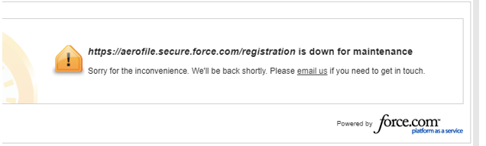
Unsuccessful Submission (cont)
Scenario B
If upon clicking on Submit and instead of the Thank You page, the applicant is however directed to the page below, this unfortunately means that there is an unplanned maintenance occurring on the AeroFile backend
We kindly advise any applicant to re-register again within the next hour.

Slide 17
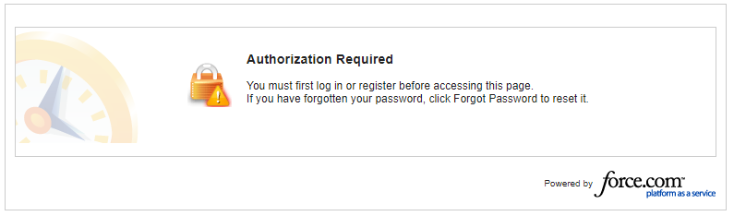
Unsuccessful Submission (cont)
Scenario C
If upon clicking on Submit and instead of the Thank You page, the applicant is however directed to a Authorisation Required page as seen below:

Slide 18
Unsuccessful Submission (cont)
To resolve this issue, kindly perform the following:
  Antivirus
  You'll see this error if you have antivirus software that provides "HTTPS protection" or "HTTPS scanning“. The antivirus is preventing browsers from providing security.
  To fix the problem, turn off your antivirus software. If the page works after turning off the software, proceed to re-submit your registration before turning your antivirus program back on.
  Firewall
  Certain corporate firewalls are set to be more restrictive and may disallow the registration submission process to go through. Try checking with your corporate IT services.
  Data Integrity
  There may be wrongly entered data (e.g. incorrect ICAO Code, .. etc). Kindly review all the information provided to ensure validity before clicking on the Submit button.

Slide 19
Contact Us
In the event the application has any trouble in submitting a registration, please contact us at airfile@mavcom.my.

Slide 20





Thank You
Lava Protocols Sdn. Bhd. © 2017. All Rights Reserved. This content is not to be distributed
facebook.com/LavaProtocols
linkedin.com/company/lava-protocols
instagram.com/lavaprotocols
twitter.com/lavaconnect

